Slide 1
DATA SCIENCE
10 WEEK PART TIME COURSE
Network Analysis

Slide 2
AGENDA
Network Analysis
Lab
Discussion

Slide 3
WHAT IS NETWORK ANALYSIS?
DATA SCIENCE PART TIME COURSE

Slide 5
WHAT IS A NETWORK?
Many types of real-world problems involve dependencies between observations.
For example:
Town planners are looking at vehicular flows through a city
Sociologist want to understand how people influence others that they know (if at all)
Biologists want to know how proteins regulate the actions of other proteins
Information agencies want to discover groups of adversaries

Slide 6
WHAT IS A NETWORK?
Problems involving dependencies can often be modelled as graphs, and scientists have developed methods for answering these questions called network analysis.

Slide 7
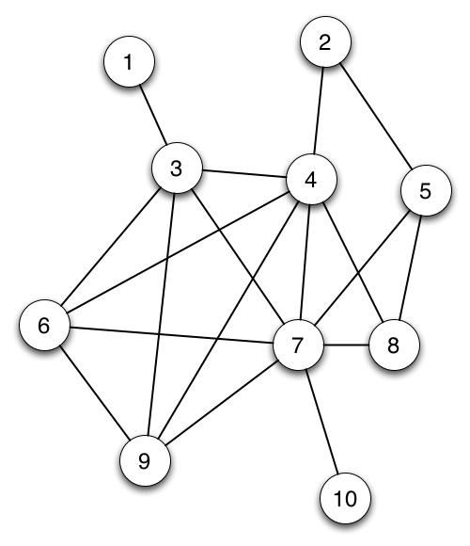
WHAT IS A GRAPH?
A graph consists of a nodes (or vertices) and are connected by edges.
For example the nodes may represent people and the edges are there if a friendship exists.
How many nodes and edges are there?

Slide 8
WHAT IS A GRAPH?
Nodes = 10
Edges = 18

Slide 9
WHAT ARE THE METRICS OF A GRAPH?
How do we know who the key actors (nodes) are in our network ?
We need to calculate some measures of importance (or centrality).
What are some of the ways you might measure an individual’s centrality (there are multiple measures).

Slide 11
networkx
import networkx
Graph = networkx.Graph()
Graph.add_node(’Greg’)
Graph.add_node(’Karen’)
Graph.add_edge(’Greg’, ’Karen’)
print networkx.density(Graph)

Slide 12
WHAT ARE THE METRICS OF A GRAPH?
Density – connectedness of the graph: ratio of edges to total possible number of edges
Degree Centrality - number of edges a node has
Closeness Centrality - the reciprocal of the sum of the shortest path distances from one node to all n-1 other nodes. Since the sum of distances depends on the number of nodes in the graph, closeness is normalized by the sum of minimum possible distances n-1. Higher values of closeness indicate higher centrality
Betweenness Centrality - the sum of the fraction of all-pairs shortest paths that pass through the node v
Eigenvector centrality - computes the centrality for a node based on the centrality of its neighbours
Page Rank - count the number and quality of links to a page to determine a rough estimate of how important the website is. The underlying assumption is that more important websites are likely to receive more links from other websites

Slide 13
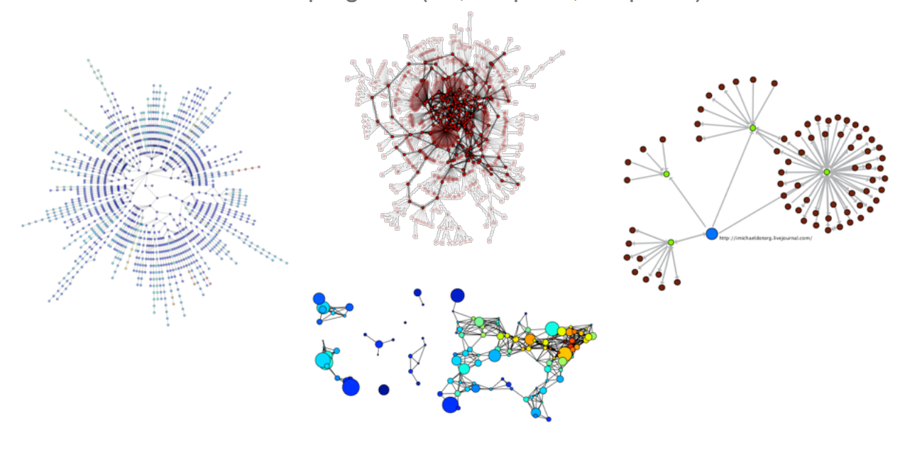
HOW DO WE VISUALISE A GRAPH?

Slide 14
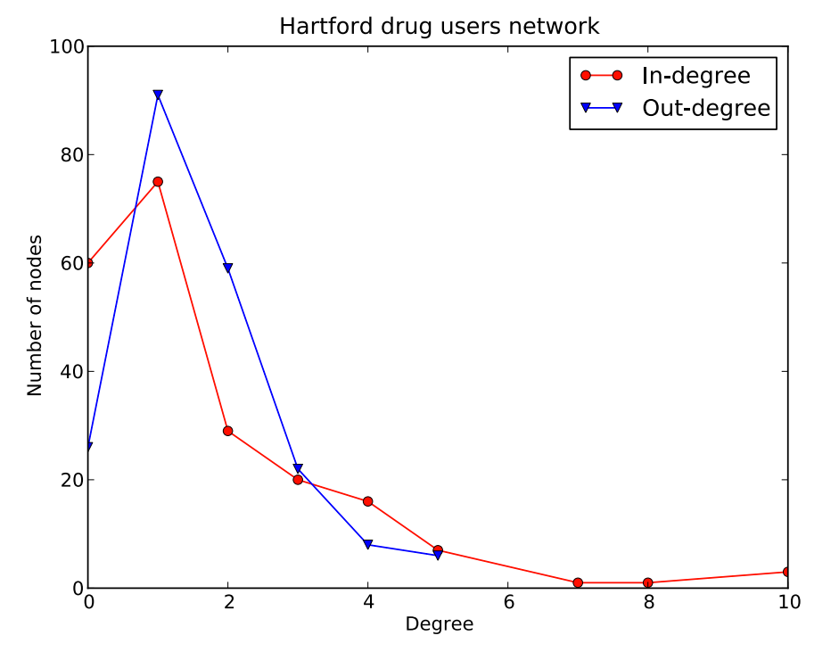
HOW DO WE VISUALISE A GRAPH?

Slide 15
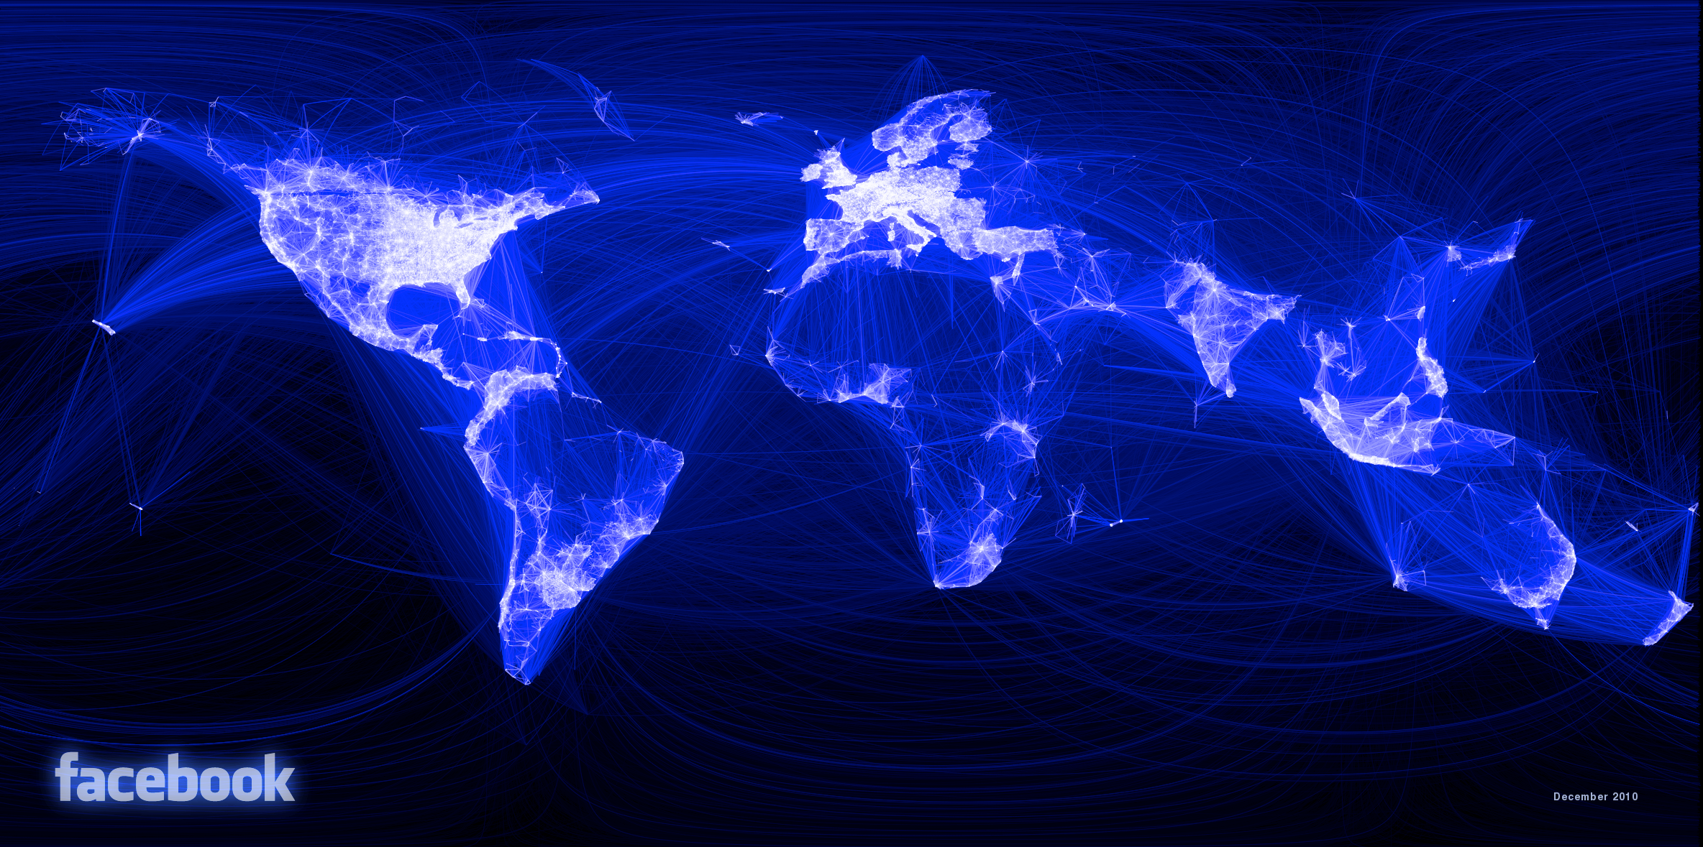
HOW DO WE VISUALISE A GRAPH?

Slide 16
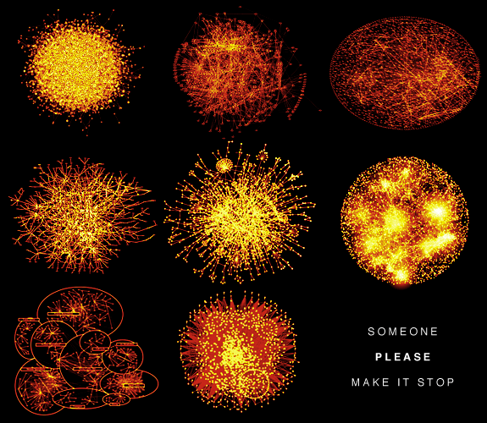
HOW DO WE VISUALISE A GRAPH?

Slide 17
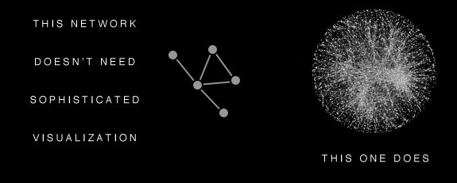
HOW DO WE VISUALISE A GRAPH?

Slide 18
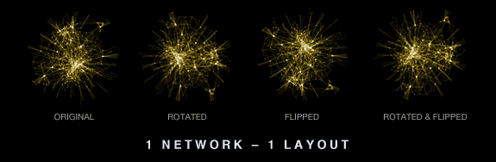
HOW DO WE VISUALISE A GRAPH?

Slide 19
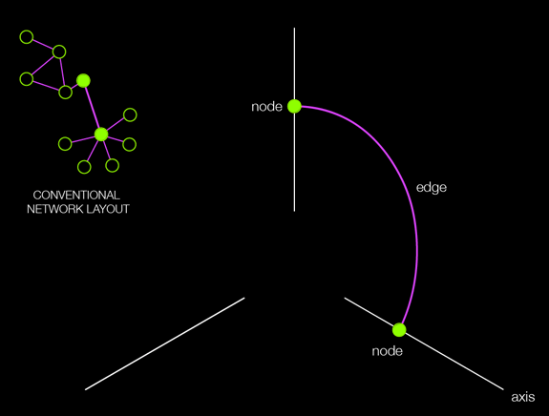
HOW DO WE VISUALISE A GRAPH?

Slide 20
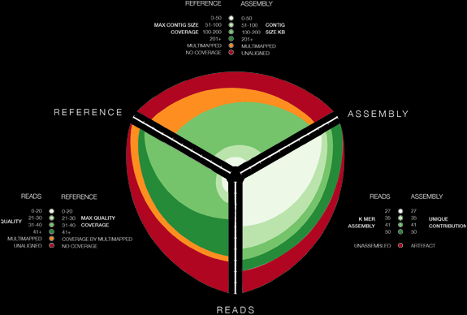
HOW DO WE VISUALISE A GRAPH?

Slide 21
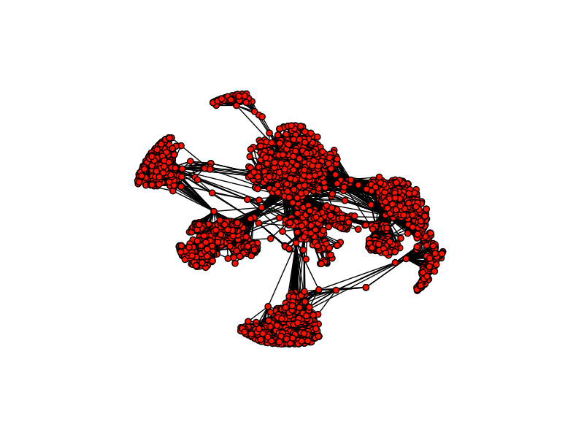
HOW CAN WE FIND COMMUNITIES?

Slide 22
HOW CAN WE FIND COMMUNITIES?
We all know on our Facebook page we have friends we made at different places and stages in our lives. We might have some work friends, school friends, some friends we made travelling, etc…
How might we find good groupings of communities?

Slide 23
HOW CAN WE FIND COMMUNITIES?
The criteria for finding good communities is similar to that for finding good clusters.
We want to maximize intra-community edges while minimizing inter-community edges.
Formally, the algorithm tries to maximize the modularity of network, or the fraction of edges that fall within the community minus the expected fraction of edges if the edges were distributed by random. Good communities should have a high number of intra-community edges, so by maximizing the modularity, we detect dense communities that have a high fraction of intra-community edges.

Slide 24
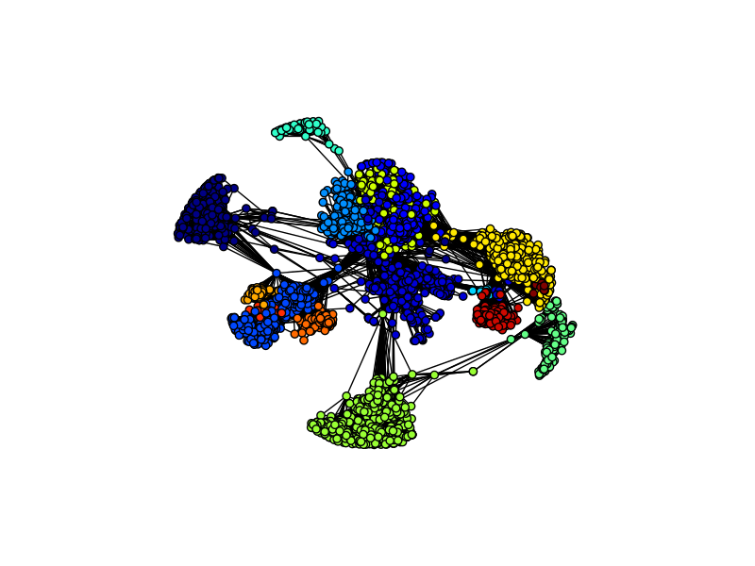
HOW CAN WE FIND COMMUNITIES?

Slide 25
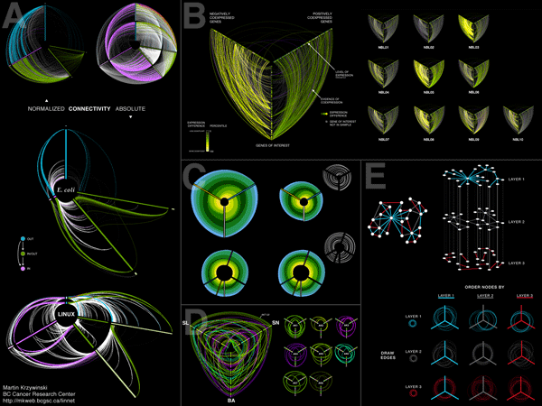
LAB
DATA SCIENCE PART TIME COURSE

